Slide 1
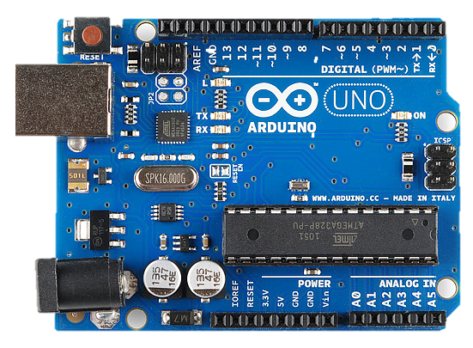
HOME AUTOMATION SYSTEM USING ARDUINO
Internet of Things Using
Arduino (COMP 1045)
Arduino: Building Tomorrow's Technology Today.

Slide 2
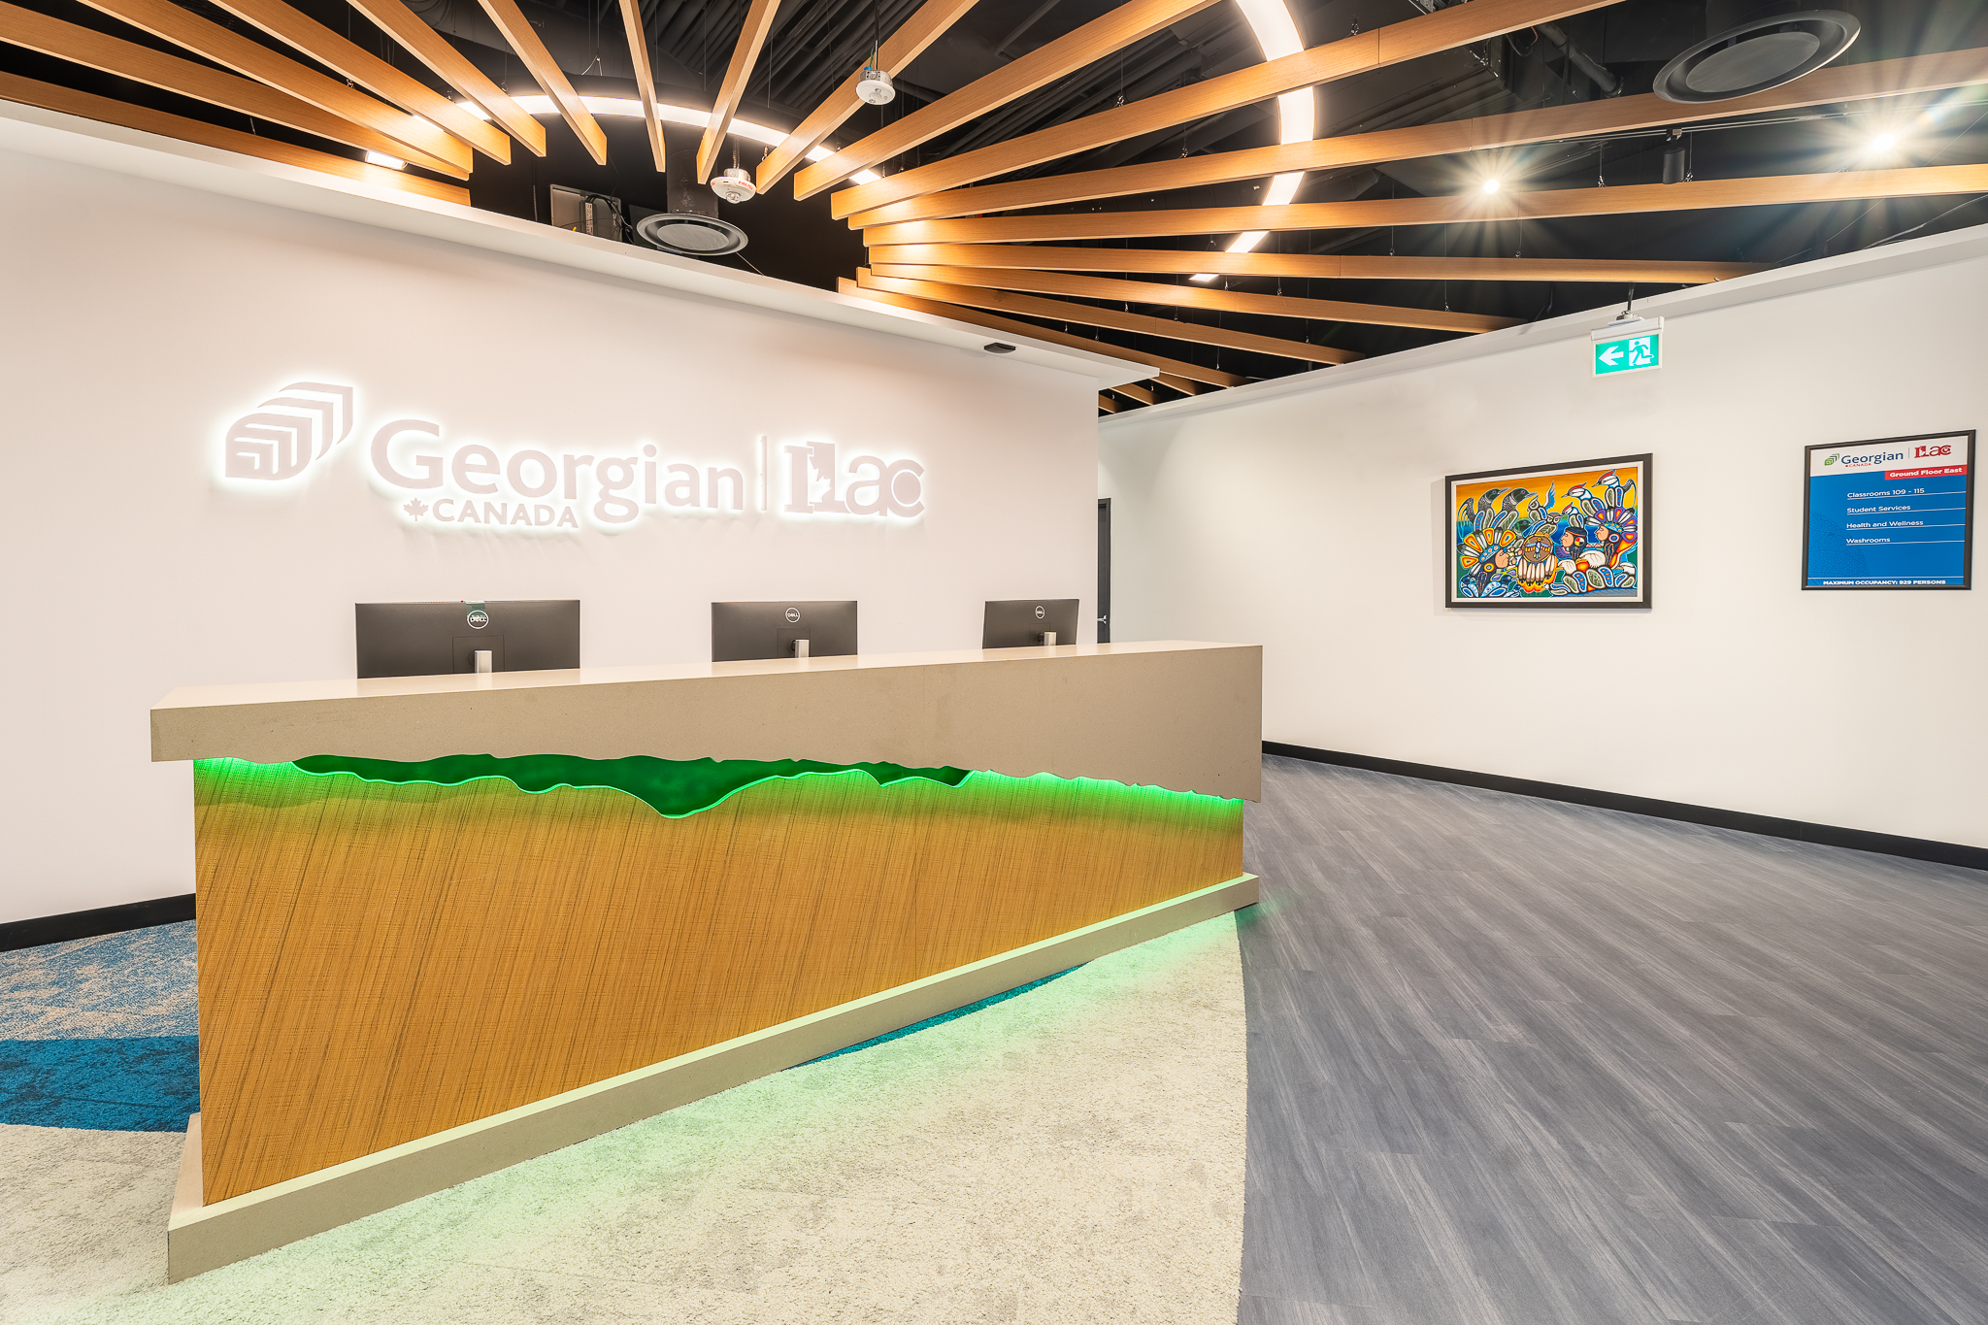

GEORGIAN@ILAC TORONTO , ON
Diploma in Computer Programming
Internet of Things (COMP 1024)
Academic Year (2024-2025)

Slide 3
About Group:
Developed / Project By:
Utsav Patel
Aditi Trivedi
Yash Patel
Smit Patel
Guided and Coordinated By:
Dr. Gurleen Kaur
Work Responsibilities:
Utsav Patel | Worked on code integration and circuit designing.
Aditi Trivedi | Worked on circuit designing and research.
Yash Patel | Worked on programming and testing.
Smit Patel | Worked on circuit designing and testing.

Slide 4
POINTS TO BE COVERED
Abstract | Basic overview about project (Home Automation System).
Requirement | Some tools and programming language used to developed this project.
Features | Features that are developed in this project.
Snap Shots | Some pictures of the projects for references.
Conclusion Resources | Main purpose of this presentation. Some resources that are used to developed this project.

Slide 5

ABSTRACT
In digital age, the Internet of Things (IoT) has transformed many aspects of everyday life, including home automation. The integration of Arduino and IoT technologies has enabled complex and adaptable home automation systems that provide homeowners with greater comfort, efficiency, and control. The suggested Home Automation System utilizes Arduino microcontrollers equipped with IoT modules. The system uses sensors, actuators, and relays to remotely monitor and manage a variety of household devices and systems via a tablet, cellphone, or online interface.

Slide 6
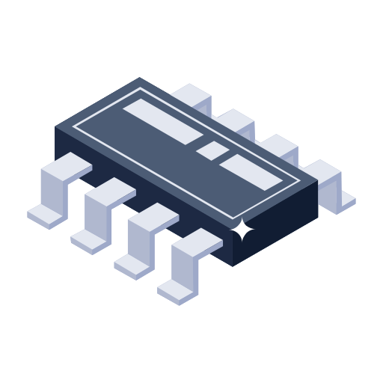

Components used:
Tools used:
Arduino Uno R3
Breadboard
Gas Sensor
Potentiometer
PIR Sensors
Resistors
Keypad 4*4
Temperature Sensors
Led
Wires
LCD 16*2
Micro Servo
Ultrasonic Distance Sensor
Website: Tinker cad
Programming Lang.: C++

Slide 7
FEATURES
SMART DOOR AUTOMATION
Control your smart door automation system using a Keypad, you can incorporate a Keypad module into your Arduino.
Room Temperature Controller
Room temperature controller using Arduino that can help maintain a comfortable environment.
DOOR OPEN AUTOMATION
Control your smart door opening using Ultra-sonic distance sensor.
GAS DETECTION
A gas detection system that controls gas leakage in smart home.

Slide 8

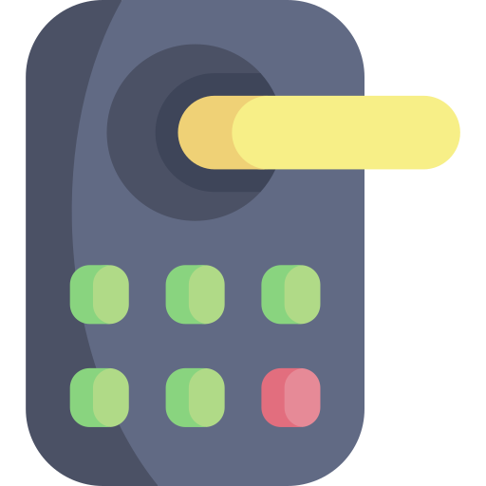
SMART DOOR AUTOMATION
PASSWORD PROTECTED
Keypad entry feature for home access.
Manual programming of user passwords directly into circuit code.
Convenient and reliable method for home entry.
Customizable access control for residents.
1
2
3
4
5
#

Slide 9

ROOM TEMP. CONTROLLER
Integration of temperature sensor with Arduino for real-time temperature monitoring.
Control fan based on temperature and PIR sensor input.
If the motion is detected or the temperature exceeds range set, turn on a fan.

Slide 10
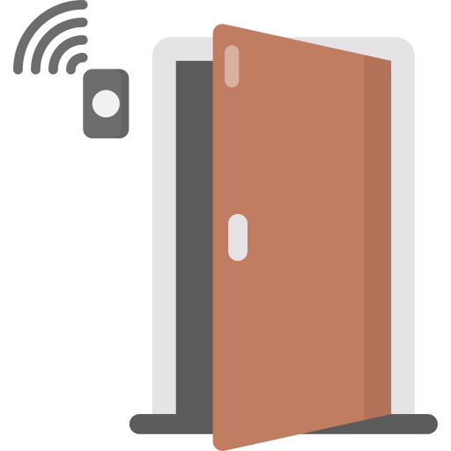
DOOR OPEN AUTOMATION
Automatic door opening feature utilizing ultrasonic distance sensor
Door opens when user approaches within a 60cm range
Door closes immediately after the object moves out of the 60cm range

Slide 11

GAS DETECTION
Sensor reads values, checks against predefined limit programmed inside code by the developer.
High gas levels trigger a buzzer.
LCD displays gas level and status information.

Slide 12

Snapshots
Some snapshots of the project for better visual representation of project’s current state.

Slide 13
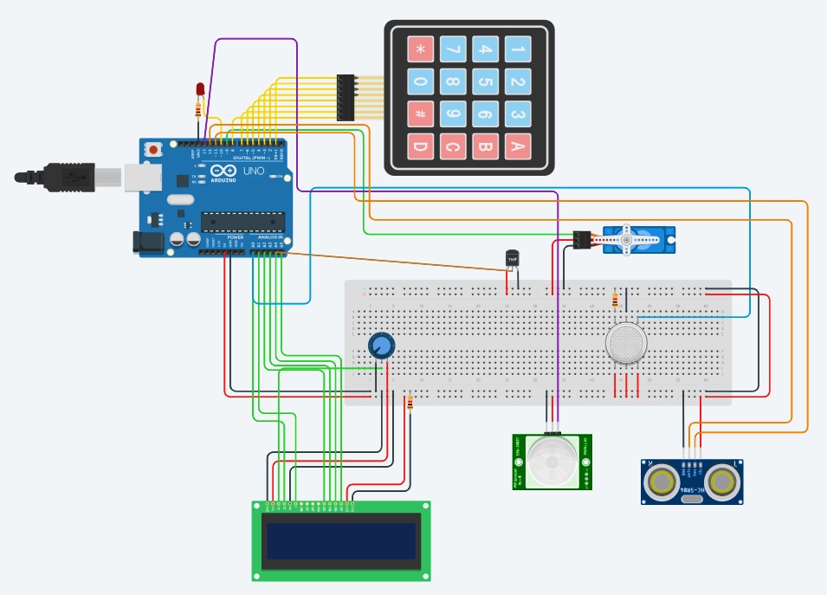

Slide 14

CONCLUSION
In conclusion, the implementation of a home automation system using Arduino offers a multitude of benefits, revolutionizing the way we interact with our living spaces. Throughout this presentation, we've explored the versatility, accessibility, and potential of Arduino in transforming ordinary homes into smart, efficient, and interconnected environments.
Efficiency and Convenience
Customization and Scalability
Affordability and Accessibility
Empowering Innovation with Arduino.

Slide 15
Bibliography
Here are some resources we used to developed this project:
https://github.com/AbhayGupta01/HomeAutomationSystem
https://github.com/RishithaRamesh/home-automation-simulation
https://stackoverflow.com
https://falvicon.com

Slide 16



Any Question or Feedback ?

Slide 17
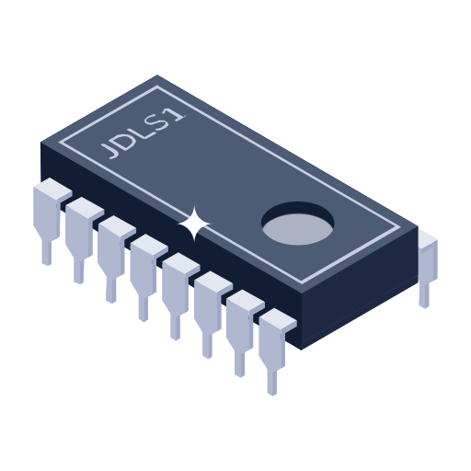

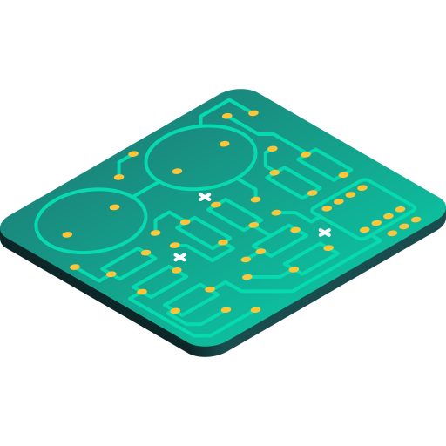
THANKS!
Arduino: Where Innovation Knows No Bounds.

